Slide 1



T20WC_BESTXI
View in Power BI
Last data refresh:
7/14/2023 5:44:36 PM UTC
Downloaded at:
7/14/2023 6:00:27 PM UTC

Slide 2
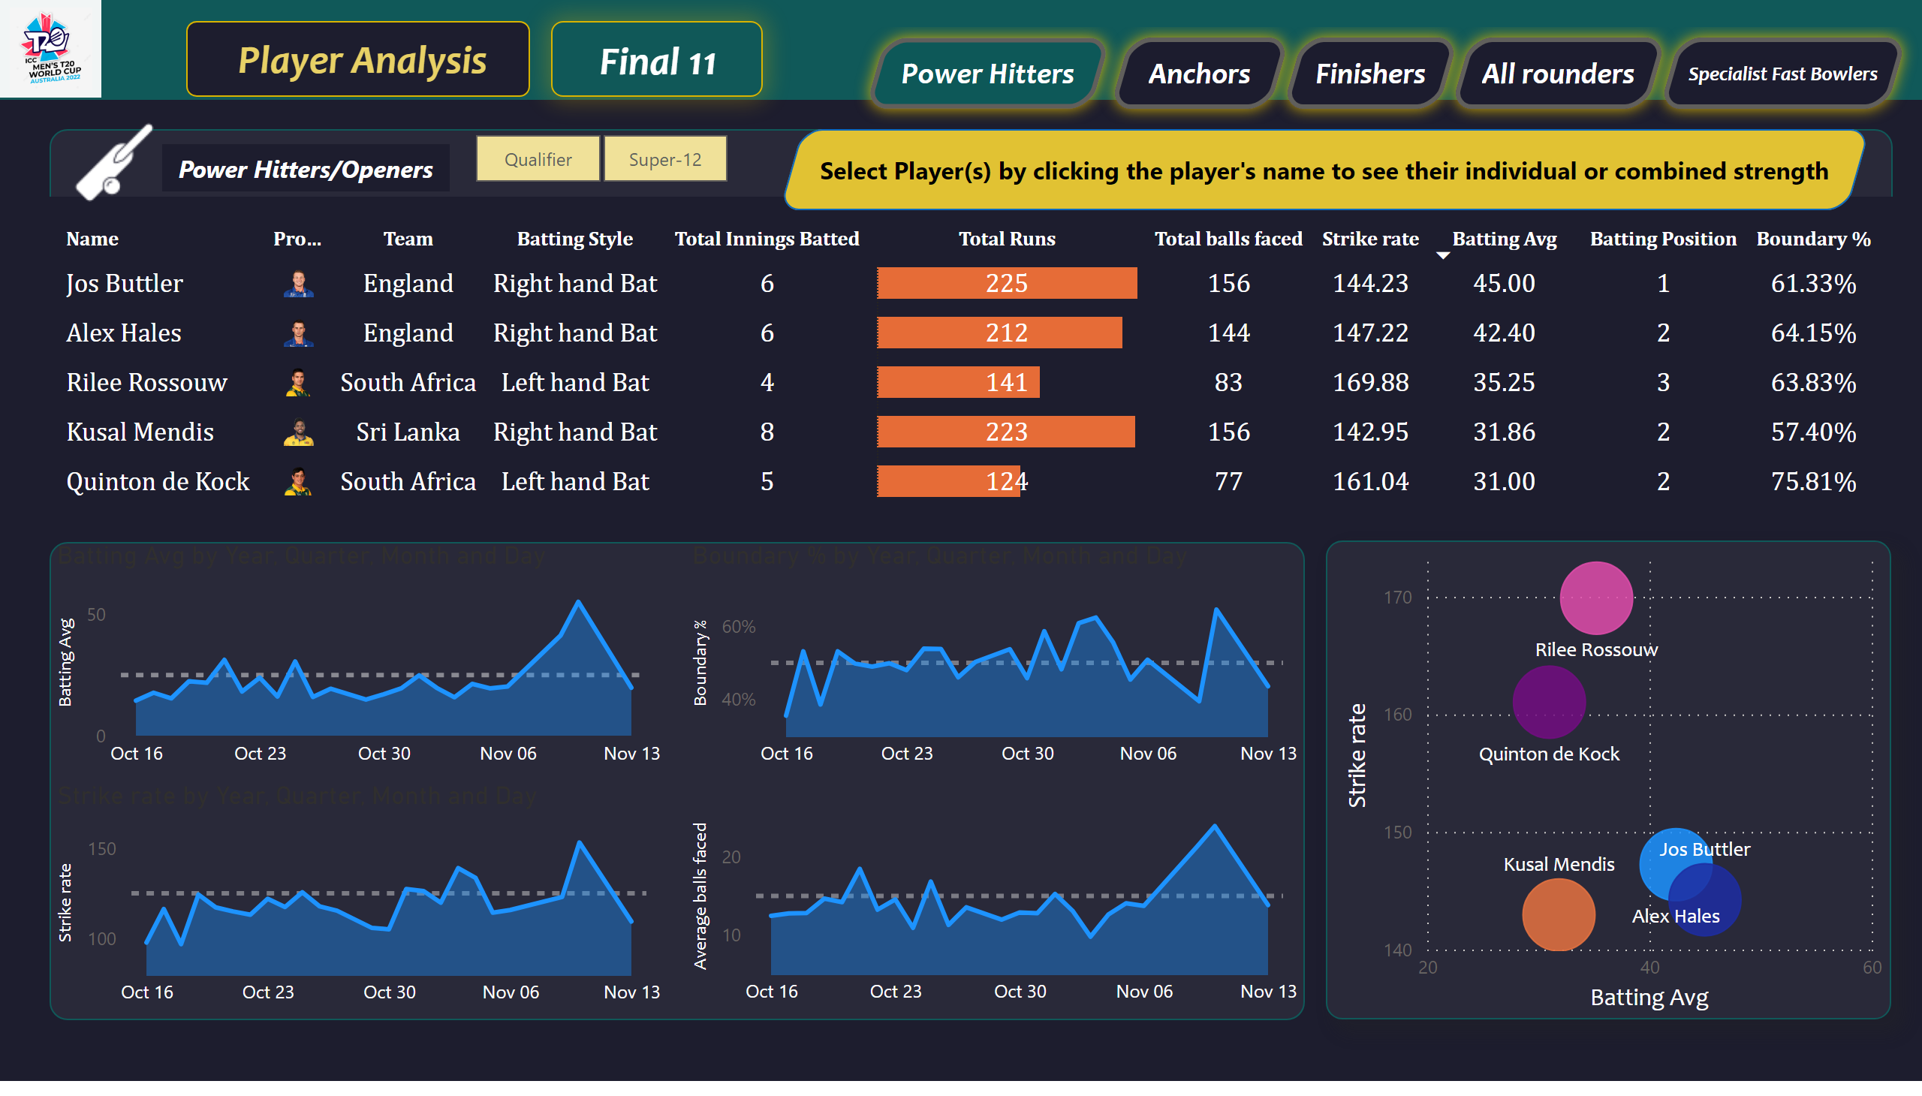
Power Hitters/Openers
Notes:
tableEx
No alt text provided
scatterChart
No alt text provided
areaChart
No alt text provided
areaChart
No alt text provided
areaChart
No alt text provided
areaChart
No alt text provided
slicer
No alt text provided
textbox
No alt text provided
textbox
No alt text provided
textbox
No alt text provided
image
No alt text provided
textbox
No alt text provided
textbox
No alt text provided
textbox
No alt text provided
shape
No alt text provided
image
No alt text provided
actionButton
No alt text provided
actionButton
No alt text provided
actionButton
No alt text provided
actionButton
No alt text provided
actionButton
No alt text provided
actionButton
No alt text provided

